Slide 1

Notes:
FON.TE SUPPLEMENTARY PENSION PLAN FOR EMPLOYEES OF TERTIARY, COMMERCE, TOURISM AND SERVICE COMPANIES
YOUR CHOICE FOR A SECURE FUTURE

Slide 2


HOW THE SUPPLEMENTARY PENSION PLAN WORKS
It is based on the pension savings set aside, thanks to which, at the end of one's working life, one can benefit from a supplementary pension.
The amount set aside, i.e. the individual position depends on:
the amount of contributions paid to the supplementary pension plan;
the length of the payment period (several years = more contributions);
the returns obtained net of costs by investing the contributions paid in the financial markets

Slide 3
OBJECTIVES OF THE COMPLEMENTARY PENSION PLAN
Building up a social security position for oneself and one's “tax dependent family members”;
Obtain a pension in addition to that paid by the mandatory social security system;
Seize the opportunity of the considerable tax benefits granted to these forms of savings;
Ensuring the adequacy of benefits to enable a decent standard of living and economic independence in retirement.

Slide 4

ABOUT US
We are the Pension Fund of the Tertiary Sector (Commerce, Tourism and Services) recognised as a non-profit association. Registered in the Covip Register under number 123.
The Supervisory Commission exercises specific control over pension funds, approves statutes and regulations and exercises control over technical, financial and asset management.
It is a negotiated fund, founded by collective bargaining as the social partners' response to employees' need for supplementary pensions
It has a long-term investment purpose, in order to ensure a pension to complement the public pension system

Slide 5
ABOUT US
More than 271 thousand members (at 31/12/2023)
Around 40 thousand member companies
More than 5 billion euro of assets managed allocated to benefits
(Italy's third largest negotiated pension fund in terms of assets managed).
4 investment sub-funds with various risk profiles and time horizons to choose from.

Slide 6
THE ORGANISATION
NON-PROFIT ASSOCIATION with equal representation (companies and workers)
Assembly of Delegates
Board of Directors
Board of Auditors

Slide 7
THE ORGANISATION
IS GOVERNED BY THE FON.TE BOARD OF DIRECTORS. THAT:
  Defines the investment policy;
  Selects asset Managers;
  Checks financial management results.

Slide 8

RETURNS AND SUB-FUNDS
Notes:
FON.TE SUPPLEMENTARY PENSION PLAN FOR EMPLOYEES OF TERTIARY, COMMERCE, TOURISM AND SERVICE COMPANIES

Slide 9
THE INVESTMENT SUB-FUNDS
When joining, the employee can choose between:
CONSERVATIVE SUB-FUND
DEVELOPMENT
SUB-FUND
DYNAMIC
SUB-FUND
GROWTH SUB-FUND
An application to change can be sent after one year in the chosen sector
sector (Switch) Go to form
HOW MUCH DOES IT COST: € 5.00 (excluding the first transaction of silent members)

Slide 10
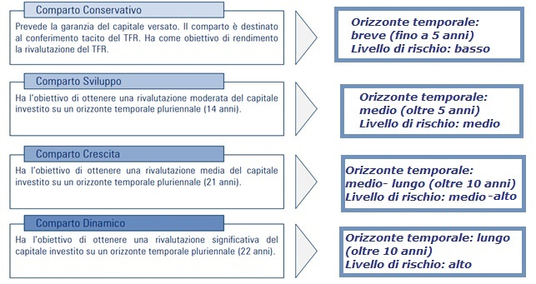
INVESTMENT SUB-FUNDS: FEATURES
Benchmark: 48%monetary/bonds; 2% shares; 50% rev. rate Severance Pay
Benchmark: 75% bond;25% equity
Benchmark: 60% bond; 40% equity
Benchmark: 40% bond; 60% equity
Notes:
Comparto Conservativo = CONSERVATIVE SUB-FUND
Prevede la garanzia del captale versato. Il comparto è destinato al conferimento tacito del TFR. Ha come obiettivo di rendimento la rivaluitazione del TFR.= It provides for the guarantee of the paid-in capital. The sub-fund is intended for the tacit conferral of severance pay. Its objective of return is the re-valuation of the severance pay.
Orizzonte temporale = Time Horizon
Breve (fino a 5 anni) = Short (up to 5 years)
Livello di rischio: Basso = Risk level: Low
Comparato Sviluppo = Development Sub-Fund
Ha l’obiettivo di ottenere una rivalutazione moderata del capitale investito su un orizzonte temporale pluriennale (14 anni) = It aims to achieve moderate capital re-valuation over a multi-year time horizon (14 years)
Orizzonte temporale = Time Horizon
Medio (oltre a 5 anni) = Medium (more than 5 years)
Livello di rischio: Basso = Risk level: Medium
Comparato Crescita = Growth Sub-Fund
Ha l’obiettivo di ottenere una rivalutazione media del capitale investito su un orizzonte tempirale pluriennale (21 anni). = It aims to achieve an average re-valuation of the invested capital over a multi-year time horizon (21 years).
Orizzonte temporale = Time Horizon
Medio-lungo (oltre 10 anni) = Medium-long (more than 10 5 years)
Livello di rischio: medio-alto = Risk level: Medium-high
Comparto Dinamico = Dynamic sub-fund
Ha l’obiettivo di ottenere una rivalutazione significative del capitale investto su un orizzonte temporale puriennale (22 anni). = It aims to achieve significant capital re-valuation of the invested capital over a multi-year time horizon (22 years).
Orizzonte temporale = Time Horizon
Lungo (oltre 10 anni) = Long (more than 10 years)
Livello di rischio: Alto = Risk level: High

Slide 11
THE BENEFITS OF BECOMING A MEMBER
Notes:
FON.TE SUPPLEMENTARY PENSION PLAN FOR EMPLOYEES OF TERTIARY, COMMERCE, TOURISM AND SERVICE COMPANIES

Slide 12
THE ADVANTAGES FOR THE MEMBER
The deductibility from income up to the value of € 5,164.57 of contributions paid (by the company, the member and any additional contributions)
NOTE: The tax saving is immediate as it is recognised directly on the payslip
The employer's contribution, when activating employer contribution
The preferential taxation at a rate of 20% of the returns (except for government bonds where taxation remains at 12.5%) obtained from the management of the accumulated capital. This is a lower rate than that applied on financial investments (26%)
Favourable tax regime on benefits paid after 1 January 2007. The previous tax regulations will continue to apply to the portion of the benefit corresponding to the amount accrued up to 31 December 2006.
The position cannot be forfeited during the accumulation phase

Slide 13
ADVANTAGES FOR THE EMPLOYER
Ministerial Decree 252/2005 provides for the following measures designed to make the loss of severance pay transferred to supplementary pension schemes less costly
payment of only the 10% solidarity contribution instead of the 23.81% social security contribution on the amounts/contributions paid to the Fund
deductibility of employer contributions from business income
cancellation of the contribution to the severance pay guarantee fund at the Italian National Social Security Institute (0.20% of the employee's annual taxable salary)
deductibility (Corporate Income Tax) from business income of a portion of the severance pay allocated to supplementary pensions to the extent of 4% of the annual severance pay if the company has at least 50 employees, 6% if it has less than 50 employees
reduction of labour costs on social contributions (so-called contingent liabilities) related to transferred severance pay flow: from 2014 on, this is 0.28
exemption from the obligation to revalue the severance pay allocated to the pension fund (1.5+75% of inflation)

Slide 14
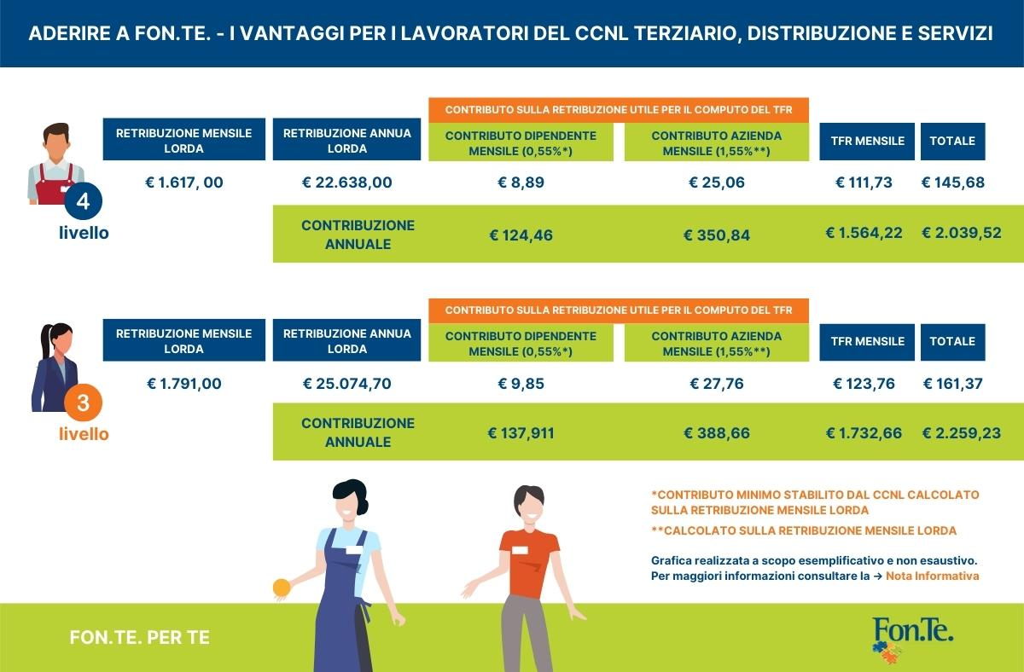
THE BENEFITS FOR THE EMPLOYEE
Notes:
ADERIRE A FON.TE = BECOME A FON.TE MEMBER
I VANTAGGU PER I LAVORATORI DEL CCNL TERZIARIO, DISTRIBUZIONE E SERVIZI = THE BENEFITS FOR WORKERS IN THE TERTIARY, DISTRIBUTION AND SERVICES SECTOR
RETRIBUZIONE MENSILE LORDA = GROSS MONTHLY SALARY
RETRIBUZIONE ANNUA LORDA = GROSS ANNUAL SALARY
CONTRIBUTO SULLA RETRIBUZIONE UTILE PER IL COMPUTO DEL TFR = CONTRIBUTION ON REMUNERATION FOR THE CALCULATION OF SEVERANCE PAY
CONTRIBUTO DIPENDETE MENSILE (0.55%*) = MONTHLY EMPLOYEE CONTRIBUTION (0.55%*)
CONTRIBUTO AZIENDA MENSILE (1.55%**) = MONTHLY COMPANY CONTRIBUTION (1.55%**)
TFR MENSILE = Monthly Severance Pay
TOTALE = TOTAL
CONTRIBUZIONE ANNUALE = ANNUAL CONTRIBUTION
*CONTRIBUTO MINIMO STABILITO DAL CCNL CALCOLATO SULA RETRIBUZIONE MENSILE LORDA = MINIMUM CONTRIBUTION ESTABLISHED BY THE NATIONAL COLLECTIVE AGREEMENT CALCULATED ON THE GROSS MONTHLY SALARY
**CALCOLATA SULLA RETRIBUZIONE MENSILE LORDA = CALCULATED ON THE GROSS MONTHLY SALARY
Grafica realizzata a scopo esemplificativo e non esaustivo. Per maggiori informazioni consultare la – Nota Informativa = Chart provided for non-exhaustive and exemplary purposes. For further information please refer to the - Information Note
FON.TE PER TE = FON.TE FOR YOU
NB: PER QUANTO RIGUARDA I NUMERI LE VIRGOLE VENGONO SOSTITUITE DAI PUNTI (.) E I PUNTI VENGONO SOSTITUITE DALLE VIRGOLE (e.g. 137,911 = 137.911)

Slide 15
WHO CAN JOIN

Slide 16
WHO CAN JOIN/EMPLOYEES
PERMANENT EMPLOYEES (full-time/part-time)
TEMPORARY EMPLOYEES
EMPLOYEES WITH LEASING CONTRACTS
APPRENTICES with Tertiary and Tourism Collective Labour Agreements
Employees who are covered by one of the reference national collective labour agreements signed by the founding parties of Fon.Te. or by the reference federations, employees of related sectors, employees resulting from merger/membership agreements (ATTACHED TO THE INFORMATION NOTE)
Persons who are fiscally dependent on the member employees may also enrol in Fon.Te. Tax dependent membership form

Slide 17

WHO CAN JOIN/SELF-EMPLOYED AND FREELANCE WORKERS (STARTING 1 APRIL 2022)
FREELANCE MEMBERSHIP FORM
Notes:
WHO CAN BECOME A FON.TE MEMBER THANKS TO THE EXPANDENING OF THE OFFER?
ENTREPRENEURS, FREELANCE AND SELF-EMPLOYED WORKERS INCLUDING OWNERS OF SMALL BUSINESSES AND FAMILY MEMBERS ASSOCIATED WITH CONFCOMMERCIO OR FILCAMS-CGIL, FISASCAT-CISL, UILTUCS.
ENTREPRENEURS, FREELANCE AND SELF-EMPLOYED WORKERS WHO COLLABORATE WITH COMPANIES BELONGING TO THE SECTORS THAT CAN APPLY FOR FON.TE

Slide 18
MEMBERSHIP TERMS
EMPLOYEES
Notes:
FON.TE SUPPLEMENTARY PENSION PLAN FOR EMPLOYEES OF TERTIARY, COMMERCE, TOURISM AND SERVICE COMPANIES

Slide 19
CAN JOIN FON.TE.
Allocating the ACCRUED SEVERANCE PAY
BY BECOMING A MEMBER OF FON.TE., FIRST-TIME WORKERS HIRED BEFORE 29.04.93, MAY:
Pay 50% or 100% of the accruing severance pay.
BY BECOMING A MEMBER OF FON.TE, FIRST-TIME WORKERS HIRED AFTER 28.04.93, MAY :
Only pay 100% of the accruing severance pay
Following the agreement of the signatory organisations of the Third Sector, Distribution and Services, Public Establishments and Employment Agencies Collective Labour Agreement, employees covered by these contracts may also choose to pay only 50%
(ATTACHED TO THE INFORMATION NOTE)
Possibility of paying a minimum contribution in addition to the severance pay, to be paid by the worker/company (NATIONAL COLLECTIVE LABOUR AGREEMENT)

Slide 20
EMPLOYEE: MEMBERSHIP TERMS/EXPLANATION 1
THE EMPLOYEE DECIDES TO BECOME A MEMBER OF FON.TE. BY PAYING ONLY Severance Pay must:
  Fill in the MEMBERSHIP FORM
  choosing the investment sub-fund
  deliver to the employer for the relevant formalities (filling in the company section and sending to the Fund)
  send the duly completed form to the Fund.
  IN THIS CASE, THE EMPLOYEE IS NOT ENTITLED TO THE EMPLOYER'S CONTRIBUTION
  The member may at any time activate his or her own contribution and thus have the employer's contribution recognised, by completing the appropriate form

Slide 21
EMPLOYEES: MEMBERSHIP TERMS/EXPLANATION 2
THE EMPLOYEE DECIDES TO BECOME A MEMBER OF FON.TE. BY PAYING THE ACCRUING SEVERANCE PAY AND THE CONTRIBUTION, must:
  Fill in the MEMBERSHIP FORM
  decide on the amount of the contribution rate to be paid by the employee, which may not be lower than the minimum amount provided for by collective agreements
  choosing the investment sub-fund
  deliver to the employer for the relevant formalities (filling in the company of section and sending to the Fund)
  IN THIS CASE, THE EMPLOYEE IS ENTITLED TO THE EMPLOYER'S CONTRIBUTION ESTABLISHED BY THE COLLECTIVE AGREEMENTS
(ATTACHED TO THE INFORMATION NOTE)

Slide 22
EMPLOYEE: TACIT MEMBERSHIP TERMS
THE EMPLOYEE:
  DOES NOT PROVIDE THE EMPLOYER, WITHIN THE FIRST 6 MONTHS OF EMPLOYMENT, WITH ANY INDICATION AS TO THE DESTINATION OF HIS OR HER SEVERANCE PAY: as a result of the tacit consent, the severance pay is paid to FON.TE.
  IS NOT ENTITLED TO THE EMPLOYER'S CONTRIBUTION ESTABLISHED BY COLLECTIVE AGREEMENT
  The member will receive confirmation of membership by mail, together with the form to activate the contribution and to possibly change the investment sub-fund
  (The Conservative Sub-Fund is the investment sub-fund for silent memberships).

Slide 23
PREVIOUS SEVERANCE PAY
In agreement with the employer, one can also request to pay the severance pay previously set aside and left in the company, but for companies with more than 50 employees which then pay the severance pay to the Treasury Fund, it is possible to pay into the Pension Fund only the amounts set aside before 2007.
PREVIOUS SEVERANCE PAY Contribution Form
Payout of PAST SEVERANCE PAY agreement
ADDITIONAL PAYMENTS
Both the participating employee and the employer may make additional, voluntary, periodic payments.
Additional Payments Form

Slide 24
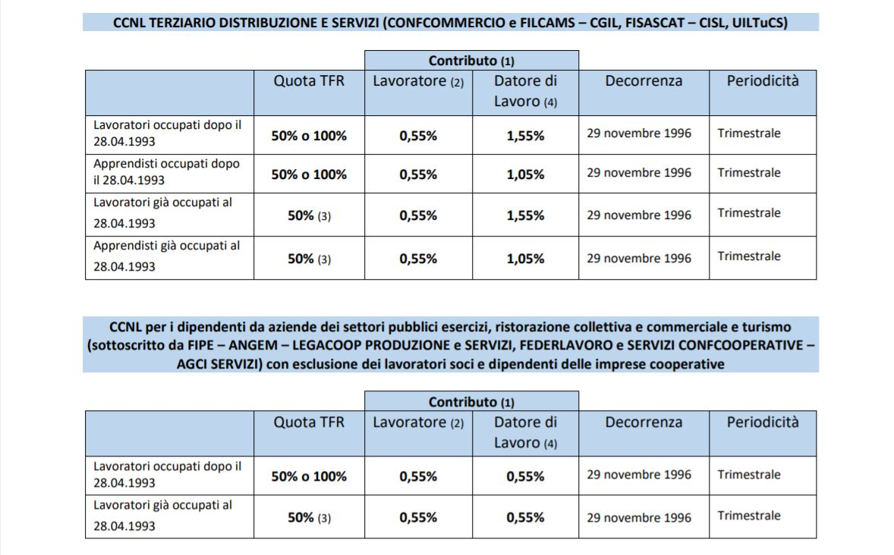
CONTRIBUTION IN ADDITION TO THE SEVERANCE PAT (OPTIONAL) PROVIDED FOR IN THE RELEVANT NATIONAL COLLECTIVE LABOUR AGREEMENTS
E.g. minimum rates of payment to be borne by the employee and borne by the company as established by collective bargaining agreements that provide for membership in Fonte (this is a percentage of the salary taken as the basis for calculating the severance pay)
Notes:
CCNL TERZIARIO DISTRIBUZIONE E SERVIZI (CONFCOMMERCIO e FILCAMS - CGIL, FISASCAT – CISL, UILTuCS) = TERTIARY DISTRIBUTION AND SERVICES INDUSTRY COLLECTIVE AGREEMENT (CONFCOMMERCIO e FILCAMS - CGIL, FISASCAT – CISL, UILTuCS)
CCNL per i dipendenti da aziende dei settori pubblici esercizi, ristorazione collettiva e commerciale e turismo (sottoscritto da FIPE – ANGEM – LEGACOOP PRODUZIONE E SERVIZI, FEDELAVORO e SERVIZI CONFCOOPERATIVE – AGCI SERVIZI) con esclusione dei lavoratori soci e dipendenti delle imprese cooperative = National collective agreement for employees of companies in the sectors of public establishments, collective and commercial catering and tourism (signed by FIPE - ANGEM - LEGACOOP PRODUZIONE AND SERVIZI, FEDELAVORO and SERVIZI CONFCOOPERATIVE - AGCI SERVIZI) with the exclusion of workers who are members and employees of cooperatives
Quota TFR = Severance Pay quota
Lavoratore = Employee
Datore di Lavoro = Employer
Decorrenza = Effective date
Periodicità = Frequency
Lavoratori occupati dopo il = Employees hired after
50% o 100% = 50% or 100%
29 Novembre 1996 = 29 November 1996
Trimestrale = Quarterly
Contributo = Contribution
NB: La virgola viene sostituita dal punto (e.g. 0,55 = 0.55)

Slide 25
WHAT SEVERANCE PAY CAN YOU PAY TO FON.TE.?
SEVERANCE PAY TO BE ACCRUED:
• You can request to pay all or part of the severance pay accruing each year according to your reference national collective labour agreement
• Legislation requires that the company always accept your request
ACCRUED SEVERANCE PAY:
• You can only pay it if it remained with the company and was not paid into the National Social Security Treasury Fund
• This requires an agreement with the employer
• You can decide from which year to request payment
• It is important to remember that severance pay accrued after 2007 and paid into Fon.Te. even subsequently benefits from the most favourable taxation, maximum 15%, minimum 9%

Slide 26
THE CONTRIBUTION

Slide 27
CONTRIBUTION PERIODICITY AND DEADLINES
The contribution to the Fon.Te. Fund is quarterly
With a view to enabling timely reconciliation of payments and avoiding delays in the investment of sums, the contribution slip must be sent by the following deadlines
1ST QUARTER (January, February, March): send slip 12 April/bank transfer order by 16 April
2nd QUARTER (April, May, June): send slip 12 July / bank transfer order by 16 July
3rd QUARTER (July, August, September): send slip 12 October/bank transfer order by 16 October
4th QUARTER (October, November, December): send slip by 12 January/bank transfer order by 16d
January
The sending of the slip is mandatory both for the reporting of ordinary contributions and for the settlement of any arrears.
Failure to send the slip does not allow the Fund to proceed with the investment of the sums paid by the employer, who will therefore be liable to pay the penalties provided for by the Articles of Association. The contribution list and the bank transfer must be of the same amount

Slide 28
HOW TO CHECK YOUR INDIVIDUAL POSITION
ON PAYSLIPS/SINGLE CERTIFICATION
IN THE RESERVED AREA OF THE WEBSITE
PENSION BENEFITS STATEMENT

Slide 29
HOW MUCH DOES IT COST TO BECOME A MEMBER

Slide 30
REGISTRATION FEES
€ 15.50 one-off registration fee of which:
  € 11.88 to be paid by the employer;
  € 3.62 to be paid by the employee;
(for cleaning companies € 7.75 to be paid by the employee, the remaining € 7.75 by the company)
€ 15.50 in the event of enrolment/membership in Fon.Te. of the member's family members who are fiscally dependent on the employee.
€ 15.49, for Associations/Institutions that are members of ANASTE (National Association of Territorial and Third Age Facilities) of which:
€ 11.88 to be paid by the employer;
€ 3.61 to be paid by the employee;
€ 10.00 for employees of Private Pharmacies of which:
€ 8.00 to be paid by the employer;
€ 2.00 to be paid by the employee;
€ 11.00 for employees of small industrial enterprises with up to 49 employees in the sectors: chemistry and chemicals, plastics and rubber, abrasives, ceramics, glass of which:
€ 7.00 to be paid by the employer;
€ 4.00 to be paid by the employee.
€ 30.00 for freelancers/self-employed persons (including owners of sole proprietorships and family members participating in family businesses);;

Slide 31
EXPENSES TO BE INCURRED DURING THE ACCUMULATION PHASE
€ 22.00 for members who make payments during the year, levied on the first payment of each year or on the first payment pertaining to the year;
€ 10.00 for members who do not make payments during the year on their individual position;
€ 15.00 for persons who are fiscally dependent on the worker enrolled with Fon.Te.; in the absence of contribution payments during the year, the cost is €10.00 to be charged to the individual position.
€ 2.00 for not choosing to receive the mandatory documentation in electronic format.
FOR FURTHER INFORMATION COST DATA SHEET

Slide 32
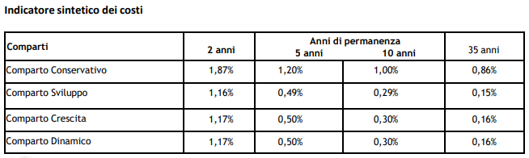
SUMMARY COST INDICATOR (SCI)
The SCI is calculated according to a COVIP-defined method, which is similar for all supplementary pension plans in which the standard costs applied by the pension plans are used.
By consulting the tables published in the sections Negotiated Pension Funds, Open pension funds and PIPs it is possible to learn about the SCI of the sub-funds into which the pension funds are divided, broken down by various holding periods (2, 5, 10 and 35 years).
USE THE FON.TE. “COMPARE COSTS” SIMULATOR
Notes:
Comparti = Sub Funds
Comparto Conservativo = Conservative Sub-Fund
Comparto Sviluppo = Development Sub-Fund
Comparto Crescita = Growth Sub-Fund
Comparto Dinamico = Dynamic Sub-Fund
Anni di permanenza= Years of retention
2 anni = 2 years
5 anni = 5 years
10 anni = 10 years
35 anni = 35 years
NB: TUTTE LE VIRGOLE NEI NUMERI DEVONO ESSERE SOSTITUTI DA UN PUNTO (.)

Slide 33
BENEFITS

Slide 34
The benefits PROVIDED BY THE FUND
ADVANCE PAYMENTS
REDEMPTION
TRANSFER
Temporary early supplementary pension
PENSION BENEFIT

Slide 35

ADVANCE PAYMENTS
Notes:
ANTICIPAZIONI – CASISTICA E MODALITA’ = ADVANCE PAYMENTS – CASES AND METHODS
Consulta il sito: Go to the website
Chiama il contact center: Call the Contact Center
L’anticipazione può essere concessa dal Fondo esclusivamente nei seguenti casi: = An advance payment may only be granted by the Fund in the following cases:
SPESE SANITARIE = HALTHCARE COSTS
ACQUISTO PRIMA CASA = PURCHASE OF FIRST HOME
INTERVENTI DI RISTRUTTURAZIONE = RENOVATION WORK
ULTERIORE ESIGENZE = OTHER REQUIEMENTS
QUANDO è RICHIEDIBILE = WHEN CAN IT BE CLAIMED?
In qualunque momento = At any time
Dopo almeno 8 anni di iscrizione = After at least 8 years of membership
IMPORTO ANTICIPABILE = AMOUNT THAT CAN BE PAID IN ADVANCE
Fino al ____% del maturato = up to ____% of the accrued amount
COME E’ TASSATO = HOW IS IT TAXED?
Con ritenuta a titolo di imposta del 15% (ridotta dello 0.30% per ogni anno successivo al 15° di partecipazione fino al raggiungimento di un minimo del 9%) = Withholding tax of 15% (reduced by 0.30% for each year after the 15th year of membership up to a minimum of 9%)
Con ritenua titolo di imposta del 23% = Withholding tax of 23%
DOCUMENTI DA INVIARE = DOCUMENTS TO BE SENT
NB: Sui montanti accumulati fino al 31/12/2006 verrà applicata la tassazione vigente in ciascun periodo fiscale. L’ammontare minimo dell’anticipazione richiedibile al Fondo è il 2.000 euro al lordo della fiscalità. = Note: The taxation in force in each tax period will be applied to the amounts accumulated up to 31/12/2006. The minimum amount of the advance payable from the Fund is 2,000 euro before tax.

Slide 36
REDEMPTIONS - TAXATION
Redemptions for medical expenses are taxed at a rate of 15%.
After 15 years of membership to the supplementary pension plan, this rate will be reduced by 0.30% for each additional year of membership, with a maximum limit of 6 points. Thus, this rate may go down to 9% if the member has participated for at least 35 years (without total redemptions).
Redemptions for the purchase of a first home, home renovation and for the additional needs of members and any other form of redemption (redemption for loss of eligibility) will be subject to a 23% flat rate withholding.
FOR MORE INFORMATION, VISIT THE REDEMPTION SECTION OF THE WEBSITE
HOW MUCH DOES IT COST: € 24.00 and an increase of € 10.00 if there is a bond in place

Slide 37
TRANSFER FOR TERMINATION OF
MEMBERSHIP REQUIREMENTS
INFOGRAPHIC TRANSFER
If the fund membership requirements are no longer met (due to termination of the work activity for which membership was envisaged, or due to a change in job classification to manager), it is possible to transfer an individual position to another supplementary pension plan to which the worker has access in relation to the new job. It should also be noted that the change of employment is only relevant in the case of a change to a different sector from those envisaged for Pension Fund membership (i.e. it is possible to change company without changing Pension Fund. NO COSTS TO BEAR
VOLUNTARY TRANSFER
While still fulfilling the requirements for participation in the Fund (i.e. without ceasing to be employed), the member may only request the transfer of the position after the time limits provided for by the regulations have elapsed (i.e. it is only possible to voluntarily change Pension Fund after 2 years of membership). HOW MUCH DOES IT COST: € 30.00 and an increase of € 10.00 if there is a bond in place.
• Please also note that the request for Transfer (voluntary or due to loss of membership requirements) can only be submitted to FON.TE. after having completed the membership to the Fund to which the pension plan is to be transferred.
TRANSFER FORM

Slide 38
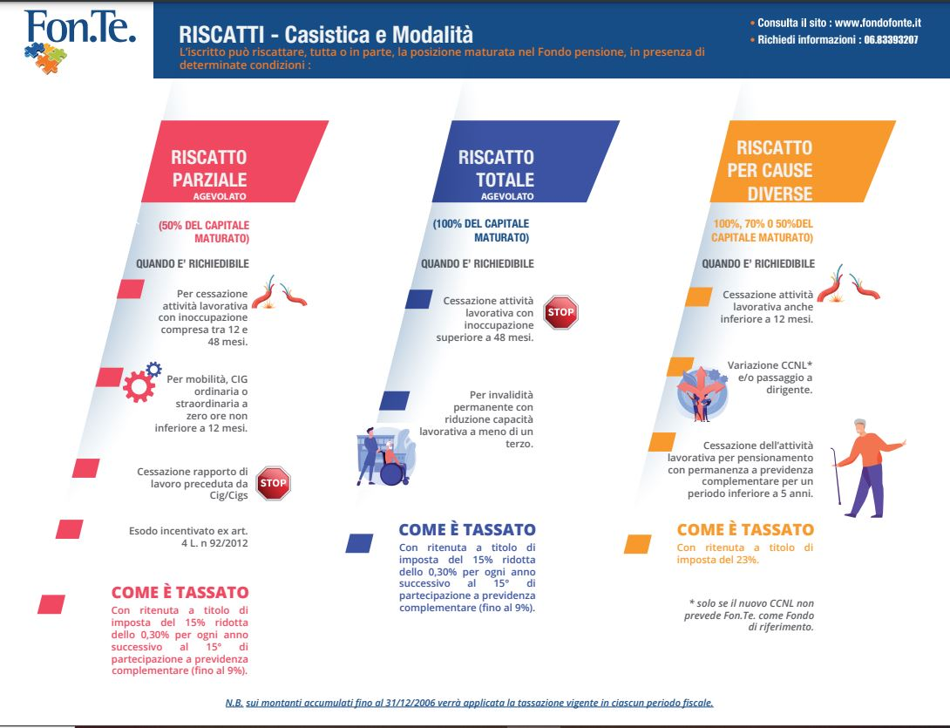
REDEMPTION OF THE CONTRIBUTION
Notes:
RISCATTI – Casistica e Modalità = REDEMPTION – Cases and Methods
L’iscritto può riscattare, tutta o in parte, la posizione maturata nel Fondo pensione, in presenza di determinate conditizioni: = A member may fully or partially redempt his or her accrued position in the pension fund if certain conditions are met:
Consulta il sito: www.fondofonte.it = Go to the website: www.fondofonte.it
Richiedi informazioni = For more information
Riscatto Parziale Agevolato = Facilitated Partial Redemption
Riscatto Totale Agevolato = Facilitated Total Redemption
Riscatto per cause diverse = Redemption for various reasons
50% del capitale maturato = 50% of the accrued capital
100% del capitale maturato = 100% of the accrued capital
100%, 70% o 50% del capitale maturato = 100% , 70% or 50% of the accrued capital
Quando è richiedibile = When can it be claimed?
Per cessazione attività lavorativa con inoccupazione compresa tra 12 e 48 mesi = When employment is termiatned for a period between 12 and 48 months.
Cessazine attività laborativa con inoccupazione superiore a 48 mesi. = When employment is termianted for a period fo more than 48 months.
Cessazone attività lavorativa anche inferiore a 12 mesi = When employment is termianted for aperiod less than 12 months.
Per mobilità, CIG ordinario o straordinatrio a zero ore non inferiore a 12 mesi = For redundancy, ordinary or extraordinary zero-hour use of the wage guarantee fund for a period greater than 12 months
Per invalidità permanente con riduzione capacità lavorativa a meno di un terzo = For permanent disability with reduction of working capacity to less than one third
Variazione CNL* e/o passagio a dirigente = Change in sector* and/or promotion to executive
Cessazione rapporto di lavoro preceduta da cig/Cigs = Termination of employment preceded by ordinary/extraordinary wage guarantee fund
Cessazione dell’attività lavorativa pensionamento con permanenza a previdenza complementare per un periodo inferiore a 5 anni = Termination of employment for retirement with continued membership of a supplementary pension plan for a period of less than 5 years
Esodo incentivato ex art. 4 L. 92/2012 = Redundancy under Article 4 of Law 92/2012
COME E’ TASSATP = WHO IS IT TAXED?
Con ritenuta a titolo di imposta del 15% ridotta dello 0.30% per ogni anno successivo al 15° di partecipazione a previdenza complementare (fino al 9%) = With 15% withholding tax reduced by 0.30% for each year after the 15th year of membership in a supplementary pension plan (up to 9%)
Con ritenuta a tiolo di imposta del 15% ridotta dello 0.30% per ogni anno successivo al 15° di partecipazione a previdenza complementare (fino al 9%) = With 15% withholding tax reduced by 0.30% for each year after the 15th year of membership in a supplementary pension plan (up to 9%)
Con ritenuta a titolo di imposta del 23% = With 23% withholding tax
Solo se il nuovo CCNL non prevede Fon.TE. Come fondo di riferimento = * Only if the new national collective agreement does not provide for Fon.TE. as a fund.
N.B: sui montanti accumulati fino al 31/12/2006 verrà applicata la tassazione vigente in ciascun periodo fiscale = Note: the taxation in force in each tax period will be applied on the accumulated amounts up to 31/12/2006.

Slide 39
TAXATION ON REDEMPTIONS
In the event of death: All accrued capital is redeemed in favour of the designated person(s) or, in the absence of designation, by the heir(s). If there are no heirs, the capital remains vested in the pension fund.
This type of redemption is taxed at a rate
of 15% reduced by 0.30% for each year after the 15th year
(Go to form)
Partial and total: as from 01/01/2007 it is taxed withholding at a rate of 15% reduced by 0.30% for each year after the 15th (Go to form)
For other causes: it is taxed at a rate of 23% (without reduction) on deducted contributions and severance pay
(Go to form)
HOW MUCH DOES IT COST:
• Total redemption: Not provided for
• Partial redemption: Not provided for
• Redemption for other causes: € 24.00 and an increase of € 10.00 if there is a bond in place

Slide 40
THE EARLY TEMPORARY SUPPLEMENTARY PENSION – R.I.T.A.
The purpose of the “Early Temporary Supplementary Pension”
(abbreviated to RITA) is to offer, through supplementary pension plans, financial support for members who are close to receiving old-age pensions and who meet the regulatory requirements. For more information see the “RITA document” Early Temporary Supplementary Pension consists in the fractional payment of the accumulated amount requested (it may concern the whole or a part of the accumulated position) and will be disbursed in quarterly instalments from when the request is accepted by the Fund until the maturity of the statutory retirement age in the mandatory plan to which it belongs. The sums to be periodically disbursed shall be invested in the most prudent sub-fund (unless otherwise chosen by the member in the application form). During the payment of the RITA, the member can still change the investment sub-fund for the remaining funds

Slide 41
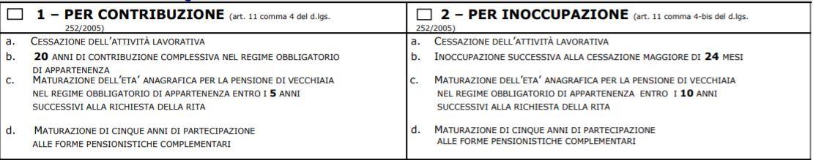
TYPES OF R.I.T.A.
HOW MUCH DOES IT COST:
RITA activation: Not provided for
RITA disbursement: €3.00
RITA revocation: €10.00
R.I.T.A. activation form
Notes:
PER CONTRIBUZIONE (ARTICOLO 11, COMMA 4 EL D.LGS 252/2005) = 1. BY CONTRIBUTION (ARTICLE 11, par. 4 of Legislative Decree 252/2005
A. Cessazione dell’attività lavorativa = Termination of employment
B. 20 anni di contribuzione complessiva nel regime obbligatorio di appartenenza = 20 years of total contributions in the mandatory pension plan
C. Maturazione dell’età anagrafica per la pensione di vecchiaia nel regime obbligatorio di appartenenza entro i 5 anni successivi alla richiesta della RITA = Attainment of the age for old age pension in the mandatory pension plan within 5 years after applying for RITA
D. Maturazione di cinque anni di partecipazione alle forme pensionistiche complementari= Five-year accrual of supplementary pension plan membership
2. Per inoccupazione (Articoo 11, comma 4-bis del D.LGS 252/2005) = For unemployment (Article 11, paragraph 4-bis of Legislative Decree 252/2005)
A. cessazione dell’attività lavorativa = Termination of employment
B. Inoccupazione successiva alla cessaziione maggiore di 24 mesi = Unemployment after termination for more than 24 months
C. Maturazione dell’età anagraifca per la pensione di vecchiaia nel regime obbligatorio di appartenenza entro i 10 anni successivi alla richiesta della RITA = Attainment of the age for old age pension in the mandatory pension plan within 10 years of applying for RITA
D: Maturzione di cinque anni di parteciipazione alle forme pensionistiche complementari= Accrual of five years of membership of supplementary pension plans

Slide 42
.
CONDITIONS FOR ACTIVATING R.I.T.A.
RITA will be accessible if the following conditions are met:
1st case (payment in instalments over a maximum advance period of 5 years)
- termination of the relationship
- not more than 5 years after reaching the age for old age pension
- minimum contribution requirement of 20 years
2nd case (disbursement in instalments over a maximum advance period of 10 years)
- unemployment of more than 24 months (after termination of employment)
- not more than 10 years after reaching the age for old age pension
In any case, 5 years of membership to the supplementary pension plan are also required (see Covip Memorandum No. 888/2018).
The retirement age to be taken into account is the age applicable when the application is made in accordance with legal provisions and relevant implementing legislation. Thus, for the time margin within which RITA is paid, the age of 67 is currently taken into account for Italian pension plans.

Slide 43
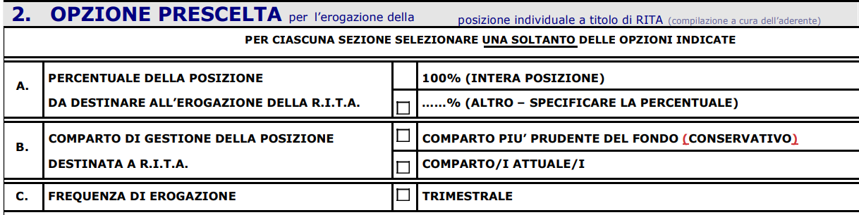
.
R.I.T.A. ACTIVATION OPTIONS
Notes:
OPZIONE PRESCELTA per l’erogazione della posizione individuale a titolo di RITA (compilazione a cura dell’aderente) = CHOSEN OPTION for the payment of the individual position as RITA (to be filled in by the member) =
A: PERCENTUALE DELLA POSIZIONE DA DESTINARE ALL’EROGAZIONE DELLA RITA = A. PERCENTAGE OF THE POSITION TO BE ALLOCATED TO THE PAYMENT OF THE ANNUITY
100% (INTERA POSIZIONE) = 100% (ENTIRE POSITION)
…-% (ALTRO- SPECIFICARE LA PRECENTUALE) = …% (OTHER – SPECIFY THE PERCENTAGE)
B. COMPARTO DI GESTIONE DELLA POSIZIONE DETINATA A RITA = B. RITA POSITION SUB-FUND
COMPARTO Più PRUDENTE DEL FONDO (CONSERVATIVO) = MOST PRUDENT SUB-FUND (CONSERVATIVE)
COMPARTO/I ATTUALE/I =CURRENT SUB-FUND(S)
FREQUNZA DI EROGAZIONE = DISBURSEMENT FREQUENCY
TRIMESTRALE = QUARTERLY

Slide 44
BENEFITS UPON RETIREMENT
CASE STUDIES AND TAX TREATMENT

Slide 45
Benefits upon retirement
SUPPLEMENTARY PENSION BENEFITS AS A LUMP SUM AND/OR ANNUITY
In the form of capital: max. 50%
In the form of an annuity:
min. 50%

Slide 46
.
PENSION BENEFITS IN CAPITAL
The member is entitled to claim the full pension benefit in lump sum (100%) should the annuity resulting from the 70% conversion of the final amount be less than 50% of the social benefit (the amount for 2023 is € 6,542.51 for 13 monthly payments).
TO UNDERSTAND WHETHER THE ENTIRE CAPITAL SUM CAN BE CLAIMED, THE SIMULATOR IS USED
Tax rate:
15% reduced by 0.30% for each year after the 15th year
From the 36th year onwards rate = 9%

Slide 47
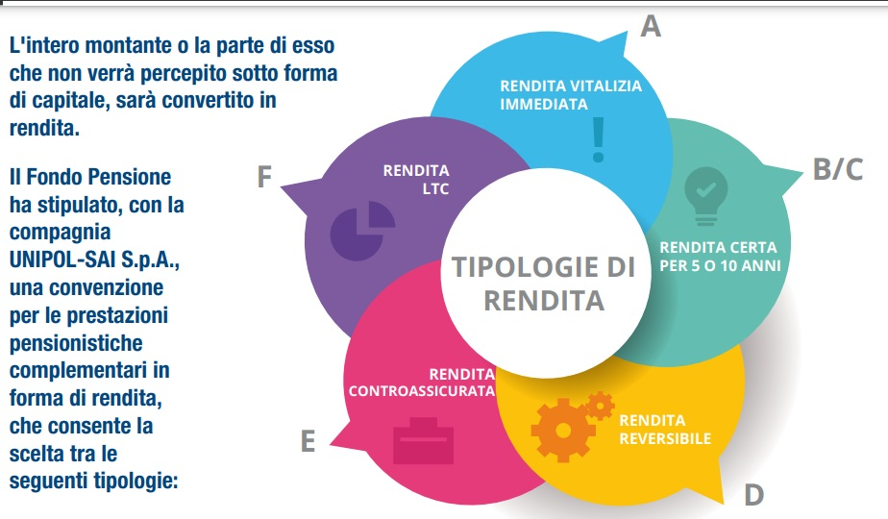
TYPES OF annuity
Notes:
L’intero montante o la parte di esso che non verrà percepito sotto forma di capitale, ,sarà convertito in rendita. = The entire amount or the part thereof that will not be received as a lump sum shall be converted into an annuity.
Il Fondo Pensione ha stipulato, con la compagnia UNIPOL – SAI SpA, una convenzione per le prestazini pensionistiche complementari in forma di rendita, che consente la scelta tra le seguenti tipologie: = The Pension Fund has entered into an agreement with UNIPOL - SAI SpA for supplementary pension services in the form of an annuity, which allows to choose from among the following types
Rendita LTC = LTC annuity
Rendita vitalizia immediata = Immediate annuity for life
Rendita certa per 5 o 10 anni = Certain annuity for 5 or 10 years
Rendita reversibile= Reversible annuity
Rendita controassicurata=Counter-insured annuity
Tipologie di rendita=Types of annuity

Slide 48
IMMEDIATE LIFE ANNUITY(A)
If an immediate life annuity is chosen, the member will receive an annuity for as long as he/she lives.
CERTAIN annuity FOR 5/10 YEARS(B/C)
In the case of choosing the 5- or 10-year certainty, the annuity will be received as long as the member is alive, but in the case of death within the first 5 years (or within the first 10 years) of retirement, the designated persons, explicitly indicated by the member, will continue to receive the annuity until the end of that period. Designated persons take over only if the death occurs within the chosen period. If death occurs after the first 5 (or 10) years of payment, the annuity is automatically terminated.

Slide 49
REVERSIBLE annuity (D)
If a reversionary annuity is chosen, the member must expressly indicate the person designated to receive this annuity, known as the reversionary (spouse, cohabitee, relative, other). This will imply the payment of an annuity to the member as long as he/she lives. In the event of death, the full amount of the annuity or a fraction thereof (determined by the member in percentage terms) will be paid to the designated person (reversionary), if surviving and for as long as he lives.
Counter-insured annuity (E)
If the counter-insured annuity is chosen, there is an immediate payment upon retirement, which will continue as long as the member is alive. With one guarantee: the return of any capital remaining after the death of the member to the persons indicated by the pensioner.

Slide 50
LTC annuity - LONG TERM CARE (F)
If the LTC is chosen, this annuity would be doubled in the event of conditions of supervening loss of self-sufficiency, for which specific care and benefits must be activated. The supervening loss of self-sufficiency provides for:
• immediate payment of the pension to the pensioner;
• if the pensioner, who is already receiving the pension, becomes non-self-sufficient for the performance of daily living acts, he/she will be paid a two-fold increase of the initial pension in accordance with the conditions stipulated in the agreement.
For more information→ ANNUITIES DOCUMENT

Slide 51
SEVERANCE PAY IN THE COMPANY VS SEVERANCE PAY TO FON.TE.
.
 | Severance pay Article 2120 | FON.TE. SEVERANCE PAY
Taxation (As of 01/01/2007) | 23% upwards (separate taxation with possible request for reclassification by the AE). | 15% to 9% or 23% - withholding tax
Additional contribution by the company. | NO | YES, provided that the member pays the contribution at its own expense.
Possibility of making voluntary contributions and enjoying deductibility | NO | Yes
Possibility to redeem 50% in case of CIG/S (12 months, zero hours) | NO | Yes
Possibility of registering tax-dependent family members | NO | Yes
Full settlement on termination of employment | Yes | Yes
Automatic liquidation on termination of employment | Yes | NO
R.I.T.A request | NO | Yes

Slide 52
.
WARNINGS
Fon.Te. Pension Fund - Supplementary Pension Fund for employees of companies in the service sector (commerce, tourism and services) registered with the Covip under number 123.
Promotional message on supplementary pension funds - before joining, please read the section of the "Key investor information" and the "Sustainability information" annex of the Information Note. More information on the Fon. Te. can be found in the full Information Note and Articles of Association, which are available on the Fund's website together with further documentation.
Past returns are not necessarily indicative of future ones.
This publication has been produced for the sole purpose of providing support to the person presenting and explaining it: it does not modify, replace or interpret the official acts and documents of the Fon.Te Fund. (available for consultation and download at www.fondofonte.it).
This teaching material is the intellectual property of the Fon.Te. Fund. Any dissemination, reproduction, copying, use without the written authorisation of the owner is prohibited.

Slide 53



Fondo Pensione Fon.Te.
Sede: Via Marco e Marcelliano, 45 – 00147 Roma
Contact Center: 06 83393207 (lun-giov 09.15-13.15/14.00-17.30
ven 09.15-13.15/14.00-15.00)
Email: protocollo@fondofonte.it
PEC: protocollofonte@legalmail.it
Sito internet: www.fondofonte.it
Follow us:
@Fon.Te.2020
@fo @fondopensionefon.te.4389
@Fondo_Fonte
Fondo Pensione Fon.Te.

Slide 54

Notes:
GRAZIE = THANK YOU

